Slide 1
Advance Excel Part 2
For IISWBM, ExPGDM Students session 2019-2020

Slide 2
Day 6 – 6th May 2019
Basic Formula & VBA Day 1 (2hrs)

Slide 3
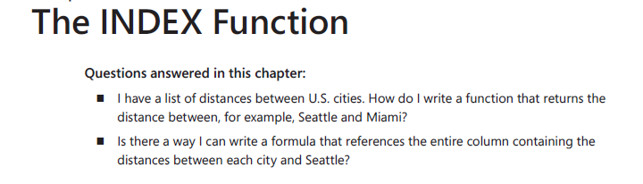
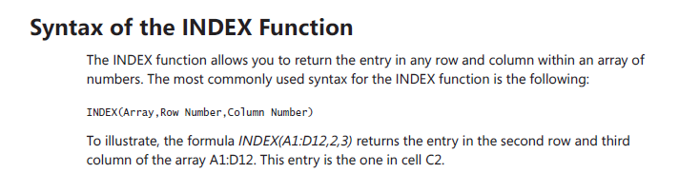
Some basic formula

Slide 4
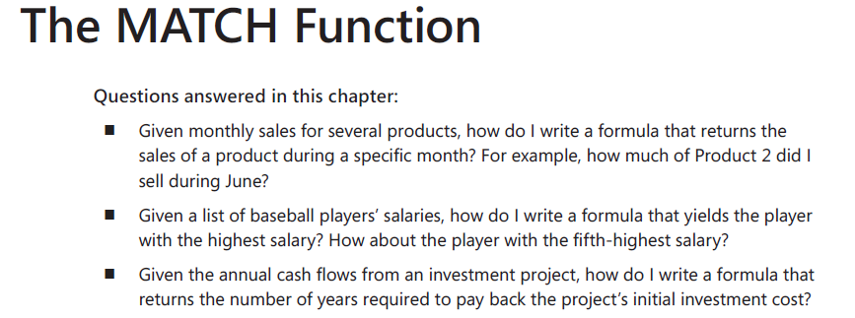
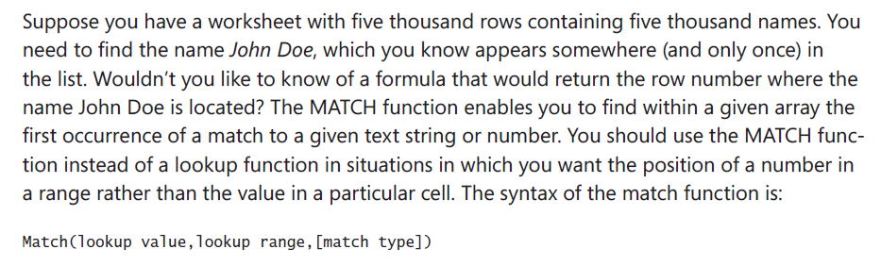
Continue …

Slide 5
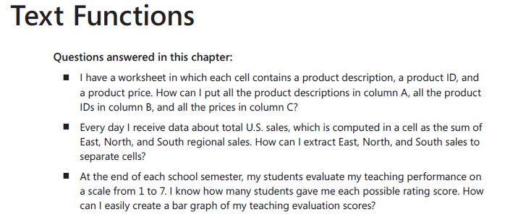
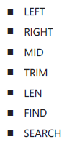
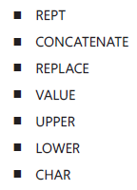
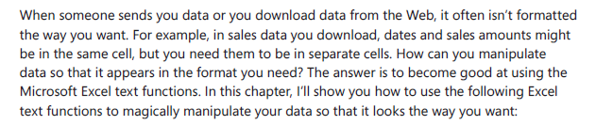
Continue …

Slide 6
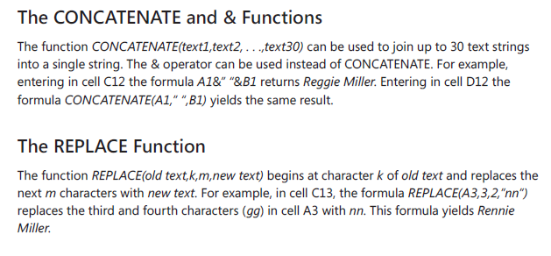
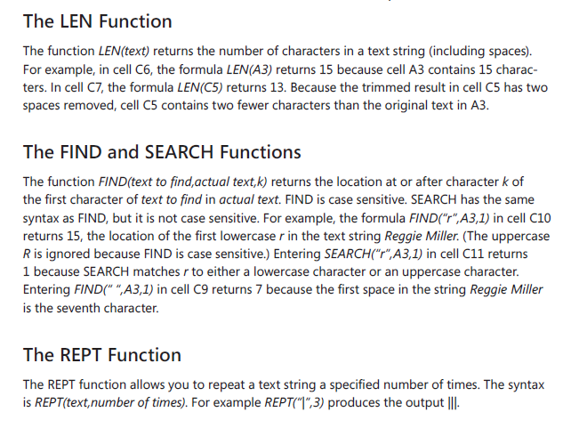
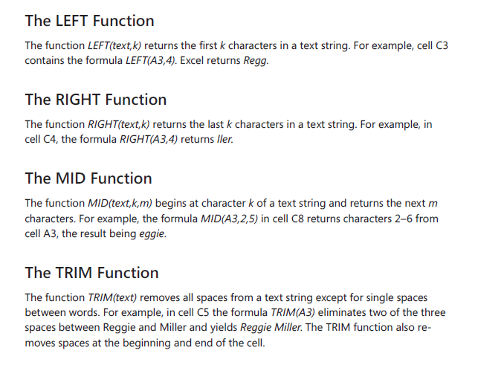
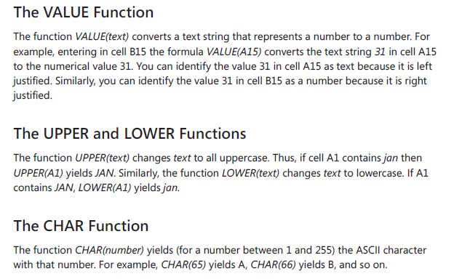
Continue …

Slide 7
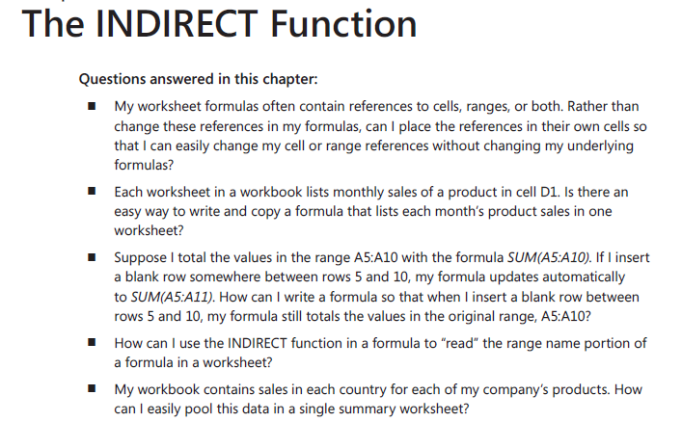
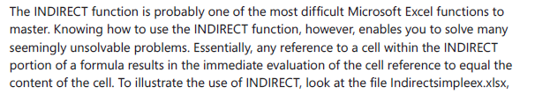
Continue …

Slide 8
VBA
VBA stands for Visual Basic for Applications an event-driven programming language from Microsoft that is now predominantly used with Microsoft office applications such as MSExcel, MS-Word, and MS-Access.
It helps techies to build customized applications and solutions to enhance the capabilities
of those applications. The advantage of this facility is that you NEED NOT have visual basic
installed on our PC, however, installing Office will implicitly help in achieving the purpose.
You can use VBA in all office versions, right from MS-Office 97 to MS-Office 2013 and also
with any of the latest versions available. Among VBA, Excel VBA is the most popular. The
advantage of using VBA is that you can build very powerful tools in MS Excel using linear
programming.

Slide 9
Application of VBA
You might wonder why to use VBA in Excel as MS-Excel itself provides loads of inbuilt functions. MS-Excel provides only basic inbuilt functions which might not be sufficient to perform complex calculations. Under such circumstances, VBA becomes the most obvious solution.
For example, it is very hard to calculate the monthly repayment of a loan using Excel’s built-in formulas. Rather, it is easy to program a VBA for such a calculation.

Slide 10
Adding Developer in menu
Step 1: First, enable 'Developer' menu in Excel 20XX. To do the same, click File ->
Options.
Step 2: Click ‘Customize the Ribbon’ tab and check 'Developer'. Click 'OK'.

Slide 11
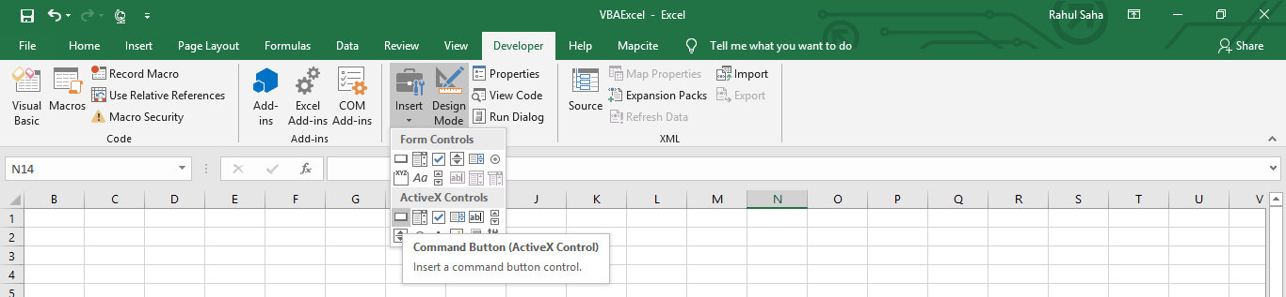
Insert Command Button
Start scripting by adding a button. Click Insert -> Select the button.

Slide 12
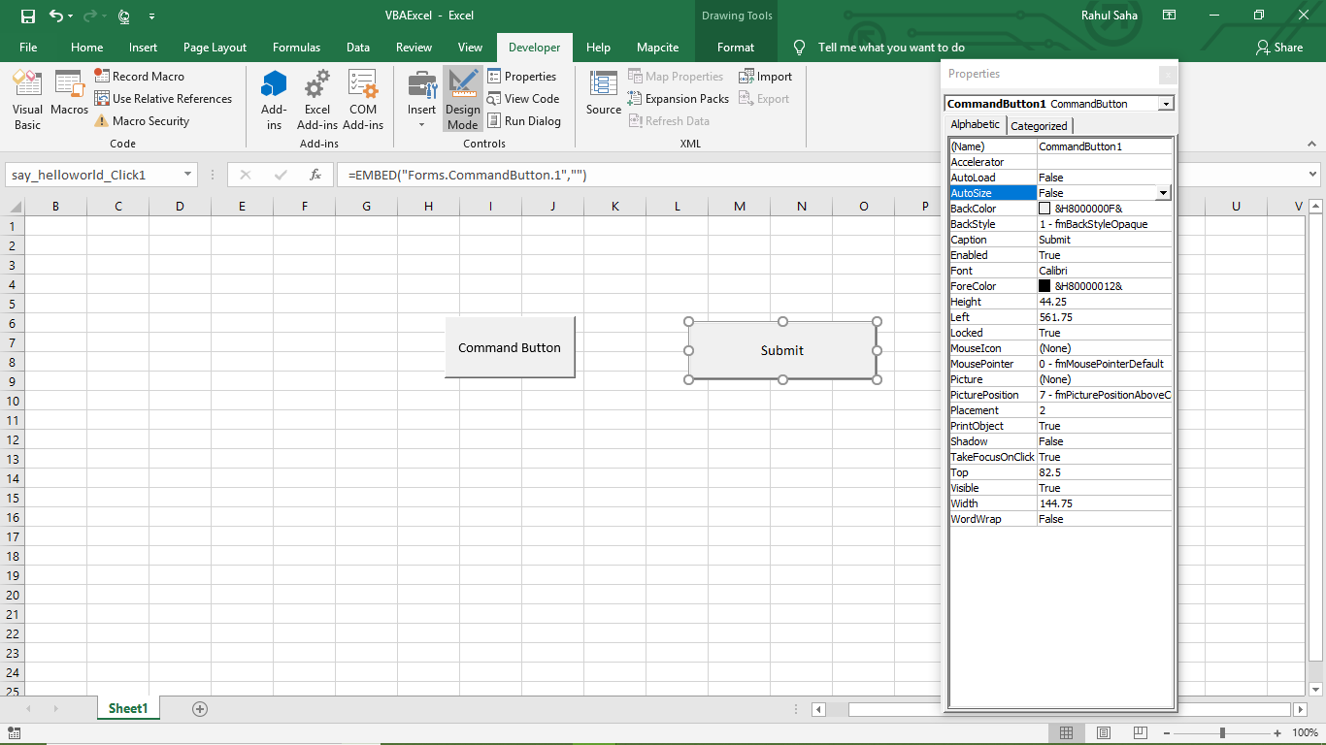
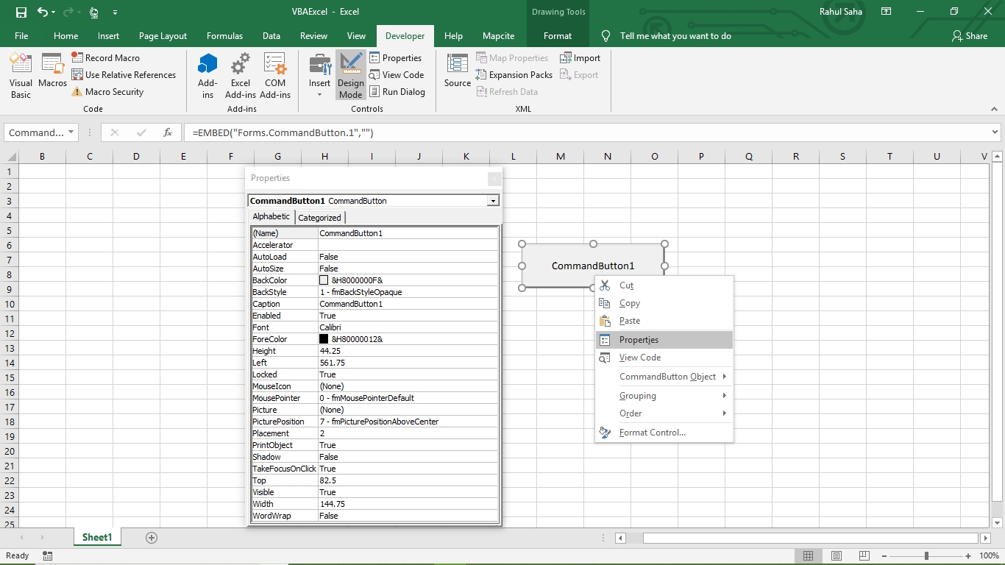
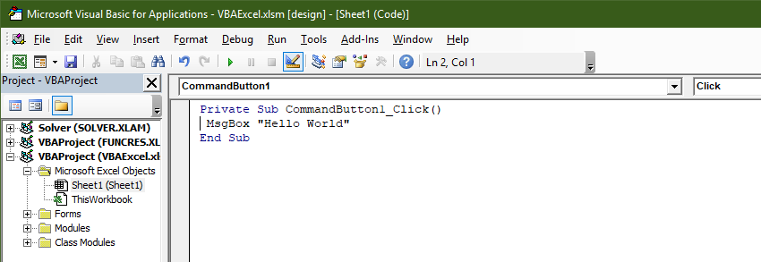
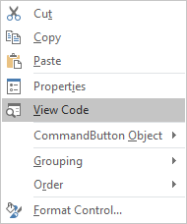
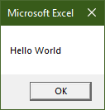
Change properties and edit code
Perform a right-click and choose 'properties'.

Slide 13
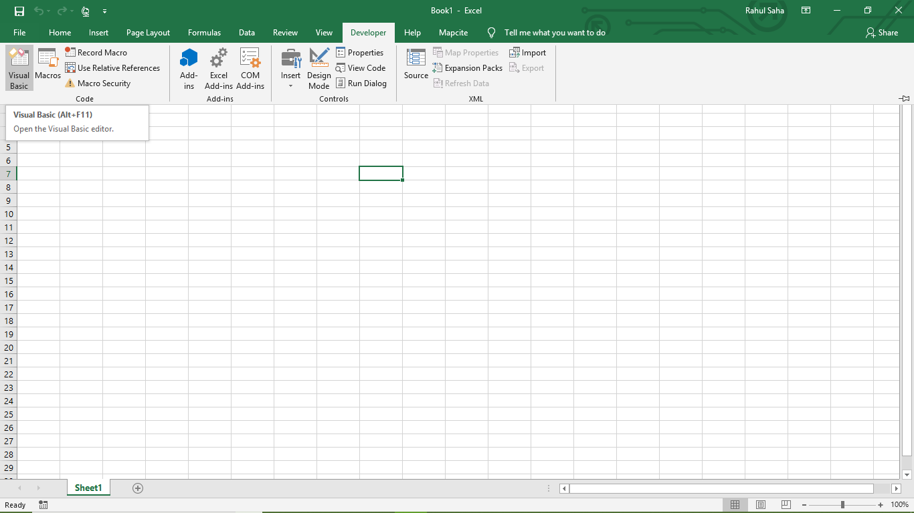
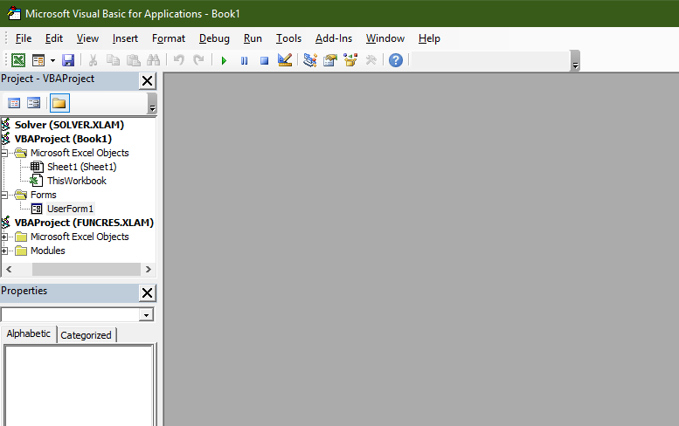
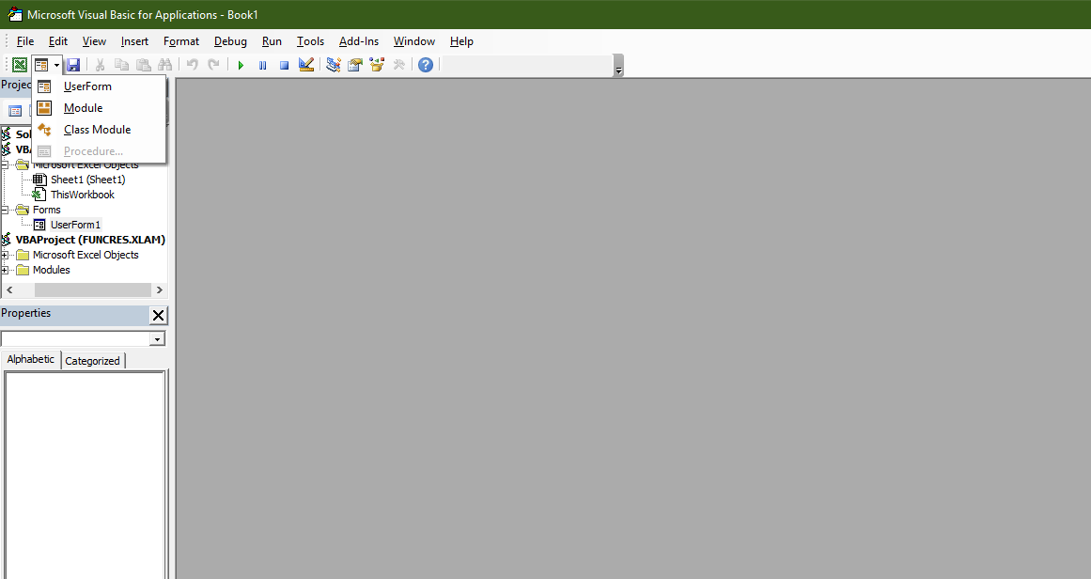
Visual Basic Editor

Slide 14
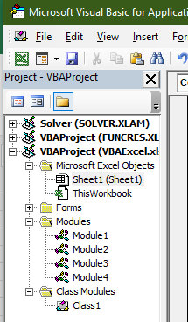
Modules
Modules is the area where the code is written. This is a new Workbook, hence there aren’t any Modules.
To insert a Module, navigate to Insert -> Module. Once a module is inserted 'module1’ is created.
Within the modules, we can write VBA code and the code is written within a Procedure. A Procedure/Sub Procedure is a series of VBA statements instructing what to do.

Slide 15
Procedure
Procedures are a group of statements executed as a whole, which instructs Excel how to perform a specific task. The task performed can be a very simple or a very complicated task. However, it is a good practice to break down complicated procedures into smaller ones.
The two main types of Procedures are Sub and Function.

Slide 16
Function
A function is a group of reusable code, which can be called anywhere in your program.
This eliminates the need of writing the same code over and over again. This helps the
programmers to divide a big program into a number of small and manageable functions.
Apart from inbuilt Functions, VBA allows to write user-defined functions as well and
statements are written between Function and End Function.
Sub-procedures
Sub-procedures work similar to functions. While sub procedures DO NOT Return a value,
functions may or may not return a value. Sub procedures CAN be called without call
keyword. Sub procedures are always enclosed within Sub and End Sub statements.

Slide 17


Macro Comments
Comments are used to document the program logic and the user information with which other programmers can seamlessly work on the same code in future.
It includes information such as developed by, modified by, and can also include incorporated logic. Comments are ignored by the interpreter while execution.
Comments in VBA are denoted by two methods.
Any statement that starts with a Single Quote
Any statement that starts with the keyword "REM".

Slide 18
Message Box
The MsgBox function displays a message box and waits for the user to click a button and then an action is performed based on the button clicked by the user.
Syntax
MsgBox(prompt[,buttons][,title][,helpfile,context])
Parameter Description
Prompt - A Required Parameter. A String that is displayed as a message in the dialog box. The maximum length of prompt is approximately 1024 characters. If the message extends to more than a line, then the lines can be separated using a carriage return character (Chr(13)) or a linefeed character (Chr(10)) between each line.

Slide 19
Continue …
Buttons - An Optional Parameter. A Numeric expression that specifies the type of buttons to display, the icon style to use, the identity of the default button, and the modality of the message box. If left blank, the default value for buttons is 0.
Title - An Optional Parameter. A String expression displayed in the title bar of the dialog box. If the title is left blank, the application name is placed in the title bar.
Helpfile - An Optional Parameter. A String expression that identifies the Help file to use for providing context-sensitive help for the dialog box.
Context - An Optional Parameter. A Numeric expression that identifies the Help context number assigned by the Help author to the appropriate Help topic. If context is provided, helpfile must also be provided.

Slide 20
Continue …
The Buttons parameter can take any of the following values:
0 vbOKOnly - Displays OK button only.
1 vbOKCancel - Displays OK and Cancel buttons.
2 vbAbortRetryIgnore - Displays Abort, Retry, and Ignore buttons.
3 vbYesNoCancel - Displays Yes, No, and Cancel buttons.
4 vbYesNo - Displays Yes and No buttons.
5 vbRetryCancel - Displays Retry and Cancel buttons.
16 vbCritical - Displays Critical Message icon.
32 vbQuestion - Displays Warning Query icon.
0 vbDefaultButton1 - First button is default.
256 vbDefaultButton2 - Second button is default.
512 vbDefaultButton3 - Third button is default.
768 vbDefaultButton4 - Fourth button is default.

Slide 21
Continue …
Return Values
The MsgBox function can return one of the following values which can be used to identify the button the user has clicked in the message box.
1 - vbOK - OK was clicked
2 - vbCancel - Cancel was clicked
3 - vbAbort - Abort was clicked
4 - vbRetry - Retry was clicked
5 - vbIgnore - Ignore was clicked
6 - vbYes - Yes was clicked
7 - vbNo - No was clicked

Slide 22
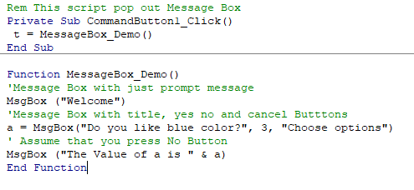
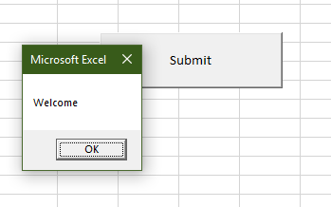
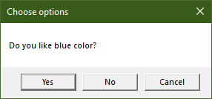
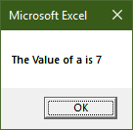
Code and output

Slide 23
InputBox
The InputBox function prompts the users to enter values. After entering the values, if the user clicks the OK button or presses ENTER on the keyboard, the InputBox function will return the text in the text box. If the user clicks the Cancel button, the function will return an empty string ("").
Syntax
InputBox(prompt[,title][,default][,xpos][,ypos][,helpfile,context])
Parameter Description
Prompt - A required parameter. A String that is displayed as a message in the dialog box. The maximum length of prompt is approximately 1024 characters. If the message extends to more than a line, then the lines can be separated using a carriage return character (Chr(13)) or a linefeed character (Chr(10)) between each line.

Slide 24
Parameter Description
Title - An optional parameter. A String expression displayed in the title bar of the dialog box. If the title is left blank, the application name is placed in the title bar.
Default - An optional parameter. A default text in the text box that the user would like to be displayed.
XPos - An optional parameter. The position of X axis represents the prompt distance from the left side of the screen horizontally. If left blank, the input box is horizontally centered.
YPos - An optional parameter. The position of Y axis represents the prompt distance from the left side of the screen vertically. If left blank, the input box is vertically centered.
Helpfile - An optional parameter. A String expression that identifies the helpfile to be used to provide context-sensitive Help for the dialog box.
Context - An optional parameter. A Numeric expression that identifies the Help context number assigned by the Help author to the appropriate Help topic. If context is provided, helpfile must also be provided.

Slide 25
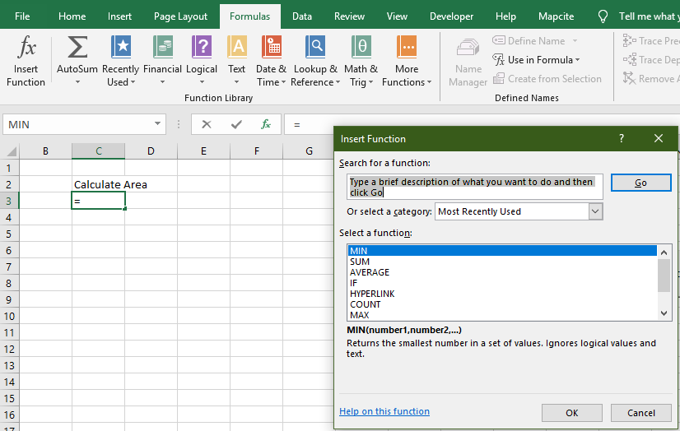
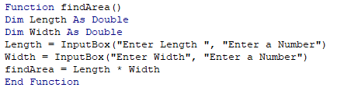
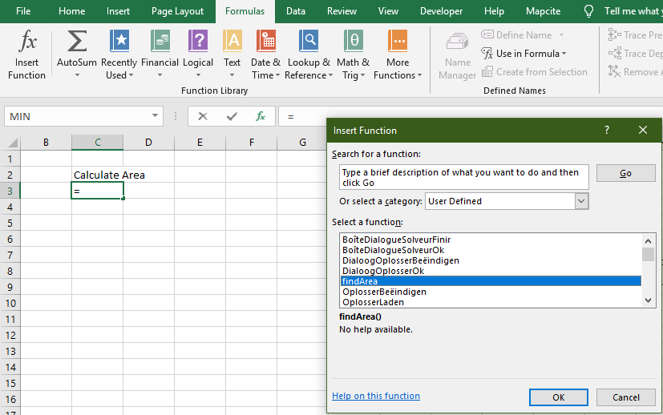
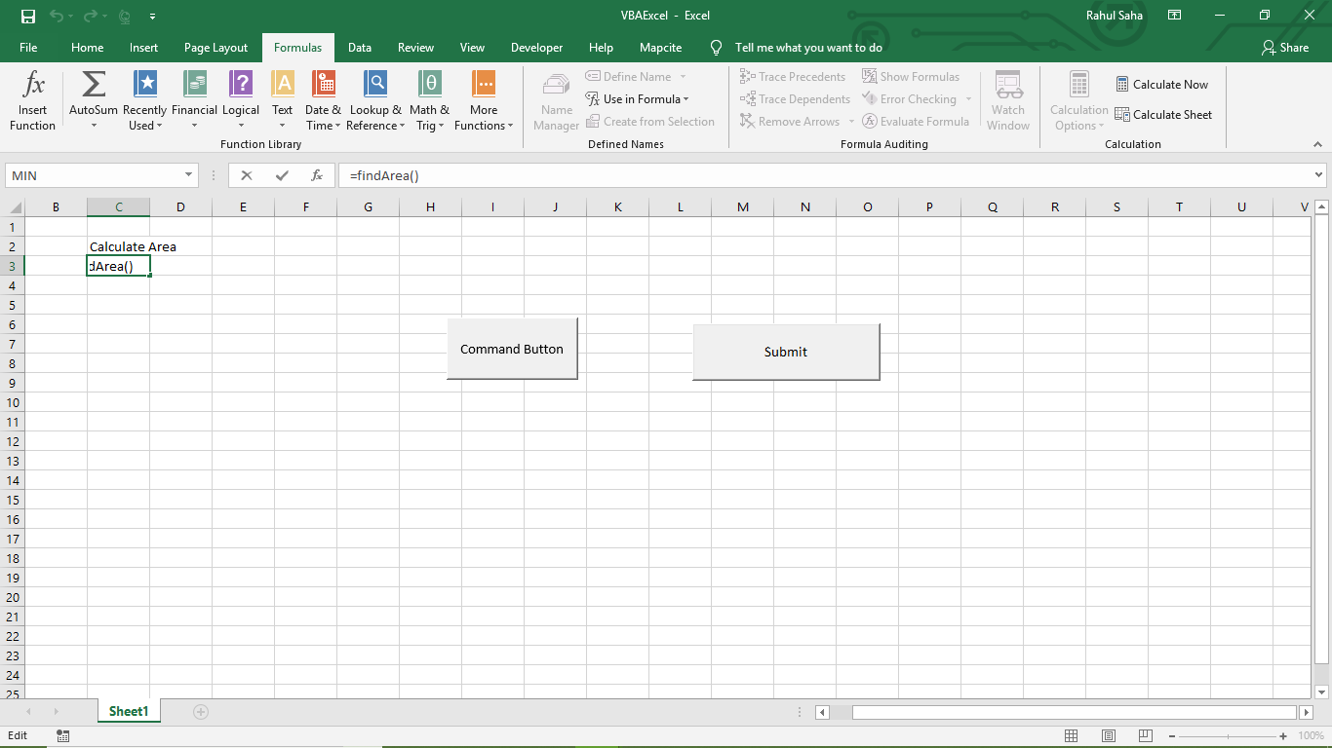
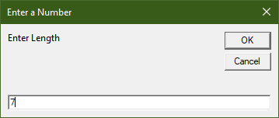
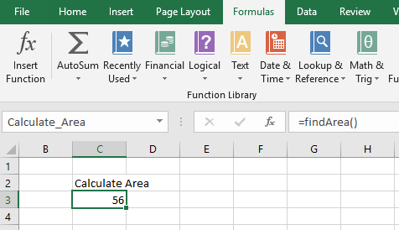

Code and output

Slide 26
Variables
Variable is a named memory location used to hold a value that can be changed during the script execution. Following are the basic rules for naming a variable.
You must use a letter as the first character.
You can't use a space, period (.), exclamation mark (!), or the characters @, &, $, # in the name.
Name can't exceed 255 characters in length.
You cannot use Visual Basic reserved keywords as variable name.
Syntax
In VBA, you need to declare the variables before using them.
Dim <<variable_name>> As <<variable_type>>

Slide 27
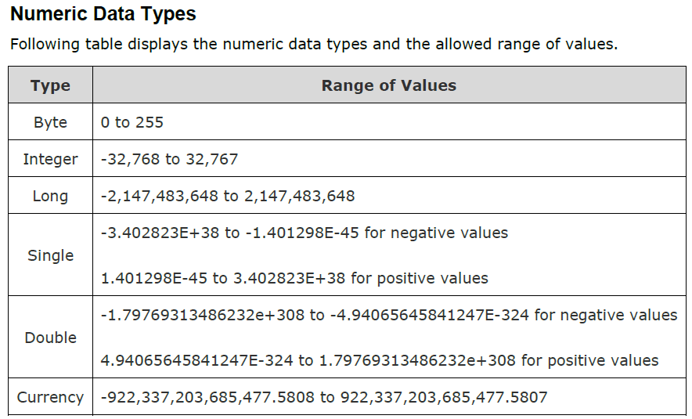
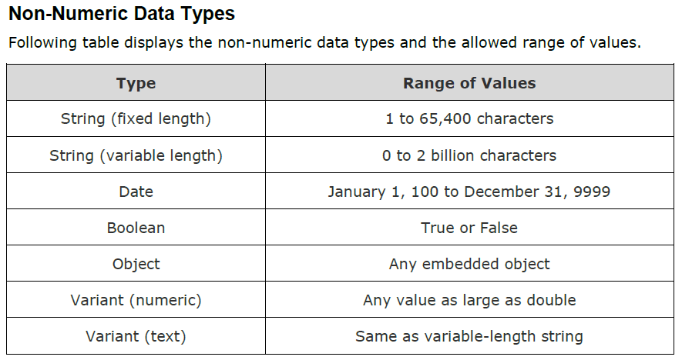
Data Types
Data Types
There are many VBA data types, which can be divided into two main categories, namely numeric and non-numeric data types.

Slide 28
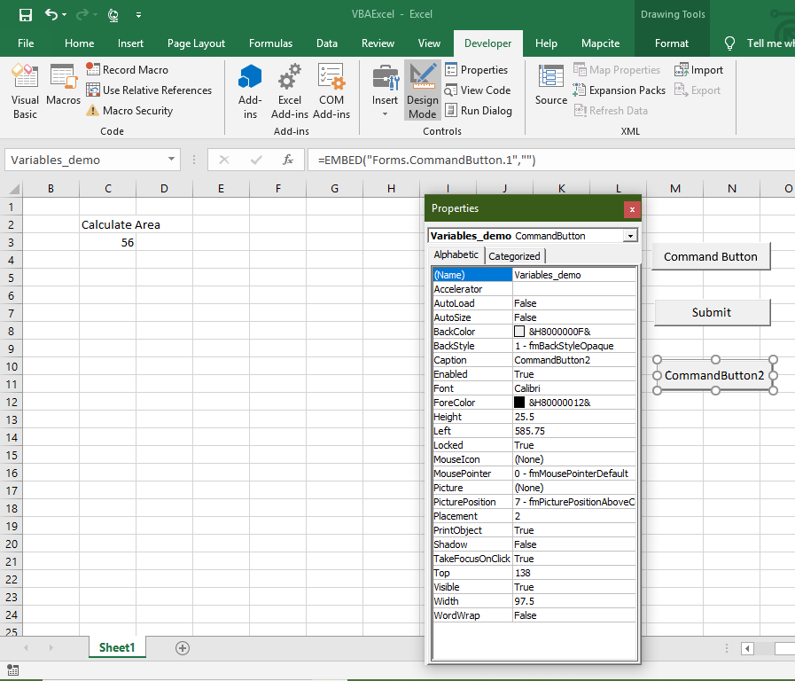
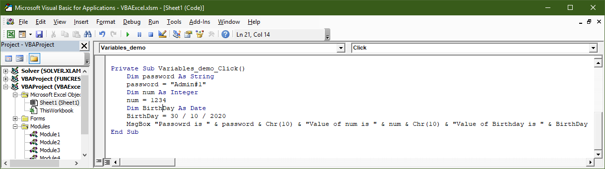
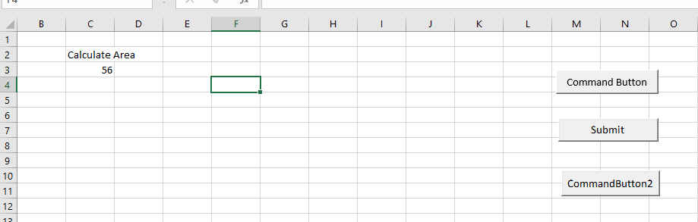
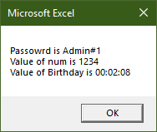
Code and output

Slide 29
Constants
Constant is a named memory location used to hold a value that CANNOT be changed during the script execution. If a user tries to change a Constant value, the script execution ends up with an error. Constants are declared the same way the variables are declared.
Following are the rules for naming a constant.
You must use a letter as the first character.
You can't use a space, period (.), exclamation mark (!), or the characters @, &, $, # in the name.
Name can't exceed 255 characters in length.
You cannot use Visual Basic reserved keywords as variable name.
Syntax
In VBA, we need to assign a value to the declared Constants. An error is thrown, if we try to change the value of the constant.
Const <<constant_name>> As <<constant_type>> = <<constant_value>>

Slide 30
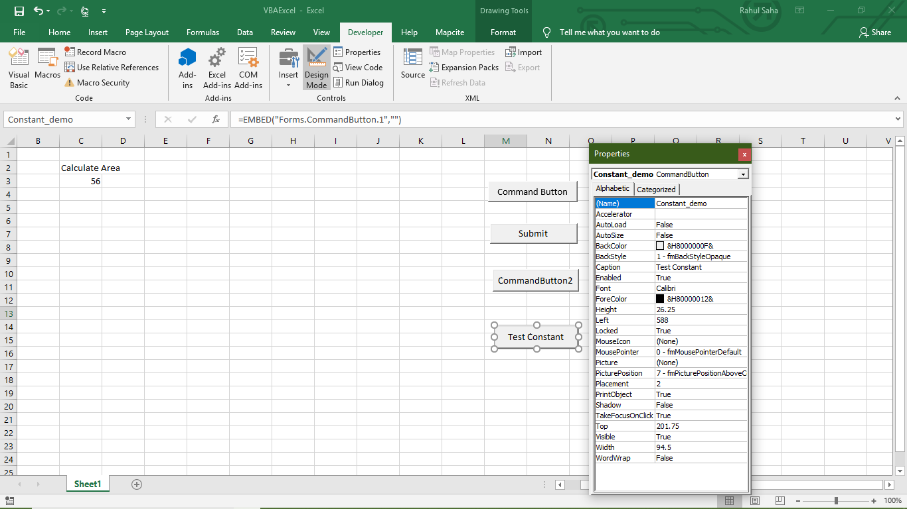
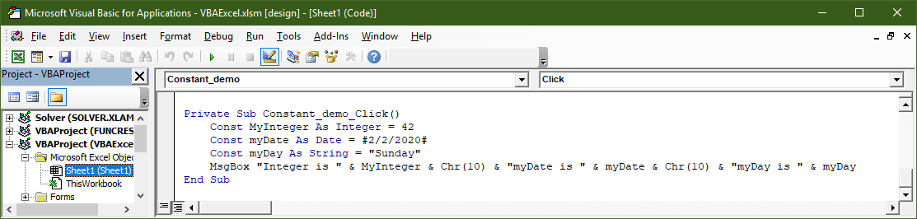
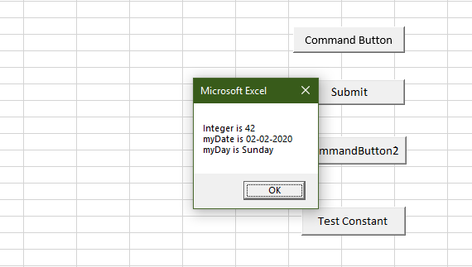
Code and output

Slide 31
Day 7 – May 2019
Day 2 (2hrs)

Slide 32
Operators
An Operator can be defined using a simple expression - 4 + 5 is equal to 9. Here, 4 and 5 are called operands and + is called operator. VBA supports following types of operators:
Arithmetic Operators
Comparison Operators
Logical (or Relational) Operators
Concatenation Operators

Slide 33
Decisions

Slide 34
Loops

Slide 35
Strings

Slide 36
Date-Time Function

Slide 37
Arrays

Slide 38
Day 8 – May 2019
Day 2 (2hrs)

Slide 39
User-Defined Functions

Slide 40
Sub Procedure

Slide 41
Events

Slide 42
Error Handling

Slide 43
Excel Objects

Slide 44
Text Files

Slide 45
Programming Charts

Slide 46
Day 9-10 –2019
Day 4-5 (4hrs)

Slide 47
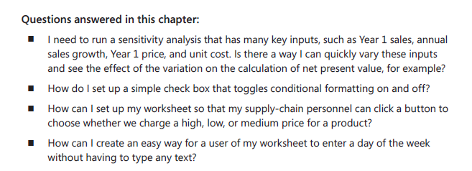
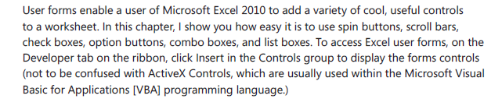
User Form in VBA

Slide 48
User Forms

